Slide 1
Operator overloading

Slide 2
Operator Overloading
The only built-in operations on classes are assignment and member selection
Other operators cannot be applied directly to class objects
C++ allows you to extend the definitions of most of the operators to work with classes
This is called operator overloading
That is, the + in a+b will add the variables if a and b are integers, but will call a different function (if overloaded) if a and b are variables of a user defined type.

Slide 3
Operator Overloading (continued)
Type of Polymorphism
Providing implementation of an already existing operator for user defined types.
Can overload most C++ operators
Cannot create new operators
Most existing operators can be overloaded to manipulate class objects
Write an operator function to overload an operator

Slide 4
Operator Overloading: Rules
You can not change numbers of operands. A binary operator (for example +) must always take two operands.
You can not change the precedence of the operators.
* comes always before +
Everything you can do with an overloaded operator you can also do with a function. However, by making your listing more intuitive, overloaded operators make your programs easier to write, read, and maintain.
Operator overloading is mostly used with objects. We will discuss this topic later more in detail.

Slide 5
Syntax
return-type class-name :: operator op (argList)
{
//function body
}
OR
return-type operator op (argList)
{
//function body
}
Where return-type is the type of value returned by the specific operation.
op is the operator being overloaded.
operator op is the function name where, where operator is a keyword.

Slide 6
What can’t be overloaded?
You can’t overload operators that don’t already exist in C++. You can overload only the built-in operators.
You cannot overload the following opertors:
Class member access operator (. (dot))
Pointer to members ( .* (dot-asterisk))
Scope resolution operator (::)
Conditional Operator (?:)
Size Operator (sizeof)

Slide 7
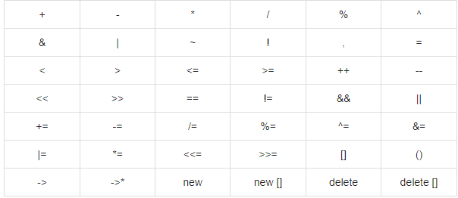
Operators that can be overloaded

Slide 8
Overloading the + operator
/* A class to define complex numbers */
class TComplex
{
float real,img;
public:
TComplex(){ real = 0; img = 0;}
TComplex(float r, float i): real(r), img(i) {}
TComplex operator + (TComplex&); // header of operator+ function
};
/* The Body of the function for operator + */
TComplex TComplex::operator + (TComplex& z)
{
TComplex result;
result.real = real + z.real;
result.img = img + z.img;
return result;
}
int main()
{
TComplex z1(3.2, 5.5);
TComplex z2(1.5, 7.0), z3;
z3 = z1 + z2; //operator +
return 0;
}

Slide 9
Overloading the assignment operator (=)
void TComplex::operator=(const ComplexT& z)
{
real = z.real;
img = z.img;
}
You don't need to write such an assignment operator function, because the operator provided by the compiler does the same thing.
In general, you don’t want to let the compiler do this for you.
With classes of any sophistication (especially if they contain pointers!) you want to explicitly create an operator =.

Slide 10
Overloading the assignment operator (=)
IntArray example (assign_op.cpp)
void IntArray::operator = (const IntArray &s)
{
size = s.size;
contents = new int[size];
//copies contents of one array to another
for (int i = 0; i < size; i++)
contents[i] = s.contents[i];
}

Slide 11
Return value of the assignment operator (=)
When there’s a void return value, you can’t chain the assignment operator (as in a = b = c ).
To fix this, the assignment operator must return a reference to the object that called the operator function (its address).
IntArray& IntArray::operator = (const IntArray &s)
{
cout<<"Overloaded Operator"<<endl;
size = s.size;
contents = new int[size];
//copies contents of one array to another
for (int i = 0; i < size; i++)
contents[i] = s.contents[i];
return *this;
} //IntArray example (assign_op.cpp)

Slide 12
Overloading Unary Operators
Unary operators operate on a single operand. Examples are the increment (++) and decrement (--) operators; the unary minus, as in -5; and the logical not (!) operator.
Unary operators take no arguments, they operate on the object for which they were called. Normally, this operator appears on the left side of the object, as in !obj, -obj, and ++obj.
Overloading the unary ++ operator (unary.cpp).

Slide 13
Overloading the “[ ]” operator
Same rules apply to all operators. So we don’t need to discuss each operator. However, we will examine some interesting operators.
One of the interesting operators is the subscript operator.
It can be declared in two different ways:
return-type& operator [ ](paramtype)
{ }
OR
const returntype& operator [] (paramtype) const {}

Slide 14
Overloading the “[ ]” operator
The first declaration can be used when the overloaded subscript operator modifies the object. The second declaration is used with a const object; in this case, the overloaded subscript operator can access but not modify the object.
SafeArray Example (safe_array_func.cpp and safe_array.cpp)

Slide 15
Operator Functions as Member Functions and Nonmember Functions
Most of the operators can be overloaded either as member or nonmember functions.
To make an operator function be a member or nonmember function of a class, keep the following in mind:
The function that overloads any of the operators (), [], ->, or = for a class must be declared as a member of the class.
Example (Rect.cpp)

Slide 16
Stream insertion (<<) and Stream extraction (>>) operators
Explanation with example (StreamOperators.cpp)

Slide 17
thanks

